Slide 1
Green University of Bangladesh
Computer science and engineering
Name : Jakirul Islam
ID : 193002101
Topic : Street children

Slide 2
Outline :
Introduction to street children
Characteristic of street children
Why Street Children Go to Streets
Solution of this problem
conclusion

Slide 3
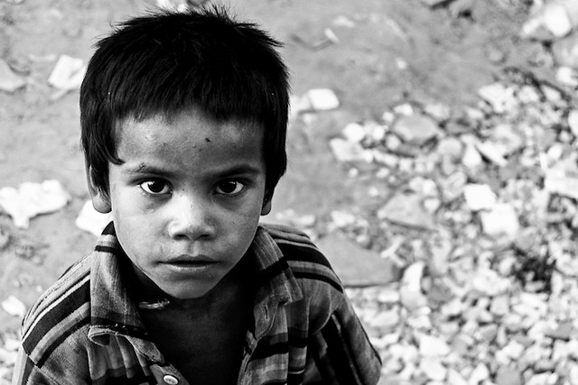
Introduction to street children:
A street children is a young person, under the age of eighteen, who lives and sleeps in the street, whose family ties are broken and who can’t return home. Street children live in the street without their families.

Slide 4
Characteristic of street children:
Street children face difficulties in providing themselves with good sources of food, clean drinking water and health care services.
They also suffer from absence of parental protection and security.
There is a lack of any kind of moral and emotional support .
The average age at which street children start living on the streets is between 9 and 12 years old.
.

Slide 5
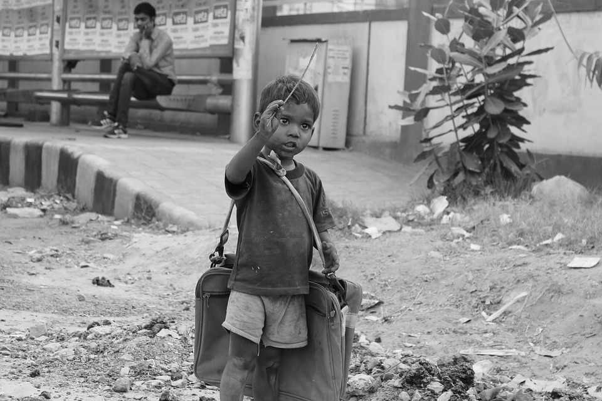
Why Street Children Go to Streets :
Children end up on the streets for a number of reasons, one of the important reasons violence (physical, verbal, sexual abuse) in the family .
If the child loose one or both parents or if it is a breakdown family.

Slide 6
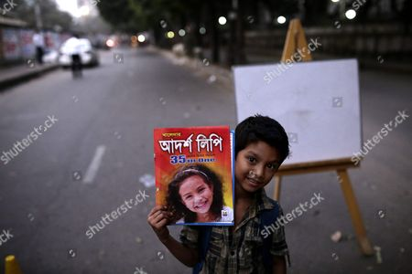
Solution of this problem:
Public awareness to help street children should be increased.
Centers that help these children should be risen.
Schools may give information and offer education about these centers to their students.
Volunteers who work in these children may be increased.
Government should take a portion of our national budget for these victim children and volunteer organization should come forward.

Slide 7
conclusion:
This is an attempt to help the street children in Bangladesh .they need our help. So we should forward Our good hand to help them. For doing this kind of great job money is not only the solution. It needs the people with good heart. To ensure children rights , all sorts of people Should come to help street children so that they can get their rights like other children of the society.

Slide 8


Slide 9


